Slide 1
Sprint 1 Playback
Grand Prix Ecosystem Operations – Team 2

Slide 2
Project Overview
Problem / Scope
Information quality
Ambiguity
Clarification overhead
Unguided user experience
Poor data visualisation
Current Workflow
Monday.com form
↓
Event vendor enters networking requirements
↓
Client receives spreadsheet-style data
Notes:
Points to cover -
Client is Clint Watson from Australian Grand Prix. Requirements management platform hosted on monday.com
Current state is a Jumble of data from in a disorganized spreadsheet style that’s messy hard for engineers to track what's needed
Additionally
Pain points -
Unguided experience, difficult to fill in – poor quality data due to no field validation, etc

Slide 3
Original Plan
Understand
Discover
Explore
Validate
Research → Requirements → Design → Feasibility
Notes:
Broken down into stages:
First, understand existing workflow...
Next, identify the user's needs, pain points and requirements...
Then, develop user personas, journeys, and UX concepts...
Finally, explore technical feasibility of UX concepts...
In proposal no working features, just planning stage

Slide 4
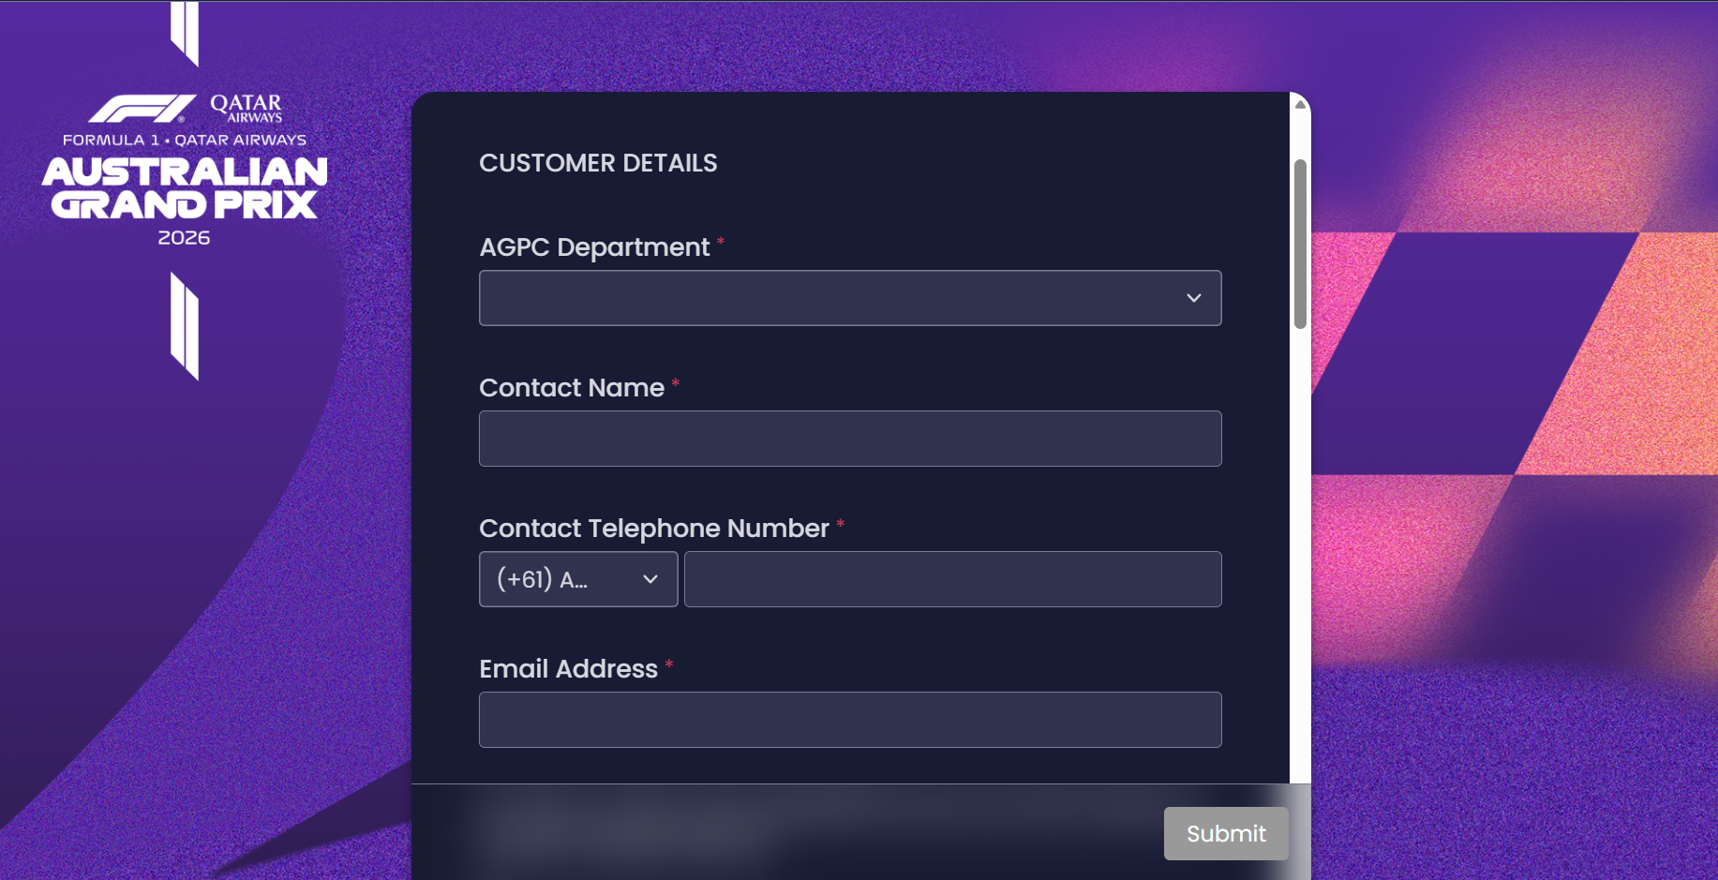
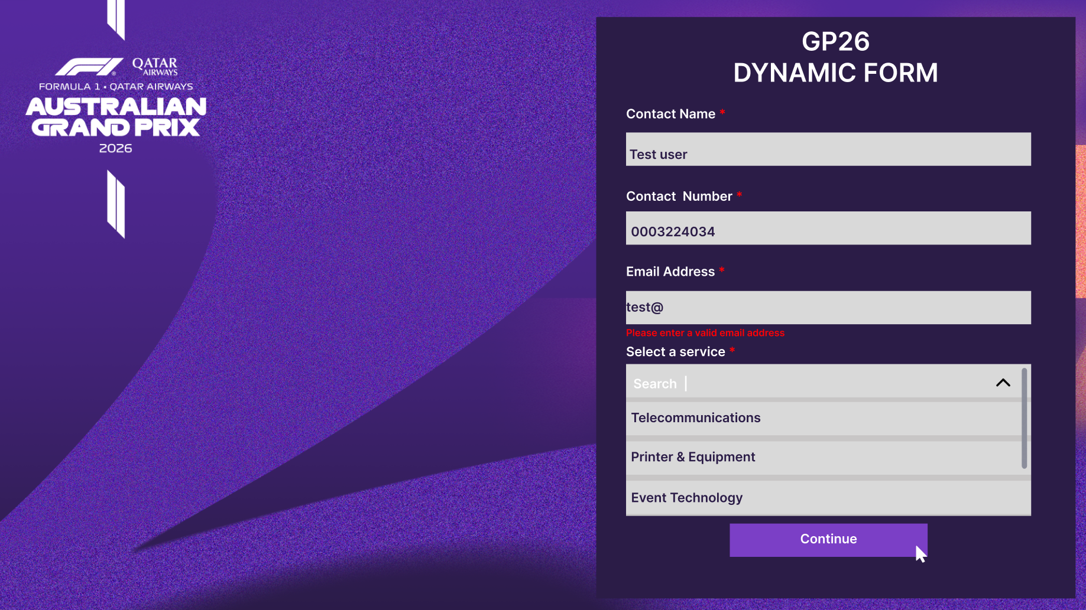
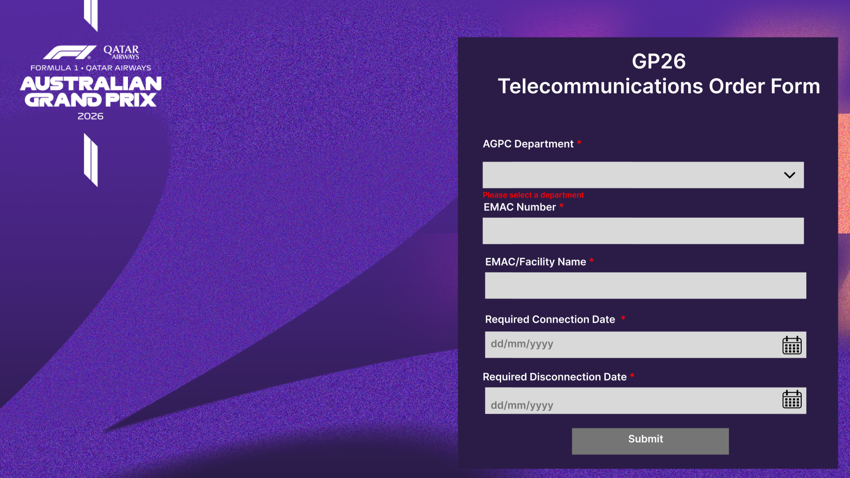
Actual Achievements
Current Form: UX Wireframes:
Notes:
On the left is the client's current form on Monday.com, all input fields are available to the vendor at once but the vendor must scroll to see all the fields.
On the right is the UX's revised wireframes, which removes the need to scroll and guides the user through the requirements elicitation process. We can see after entering the essential details for all services, selecting the networking service they require, and pressing the submit button, the user is then guided to the next part of the form containing the relevant input fields for the selected service.

Slide 5
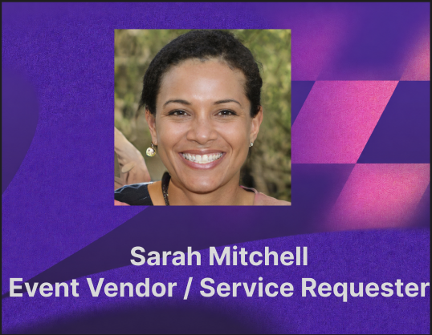
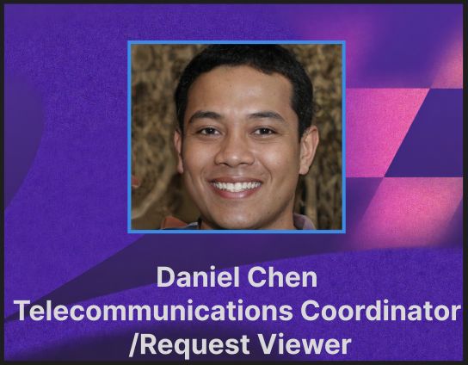
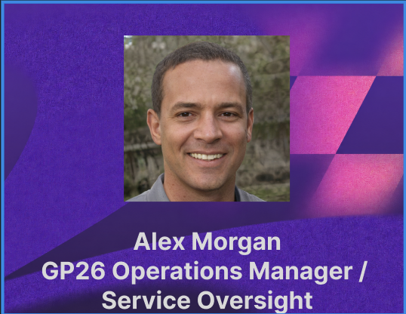
Actual Achievements
User Personas
Notes:
User personas that UX created.
Grounds our design with requirements from "real users" rather than guessing
Perspectives from vendor, telecommunications coordinator, operations manager

Slide 6
Why It Matters
Cleaner vendor requirements
Less clarification needed
Better form validation
Less technical burden
For The Client
For The Event Vendor
Cleaner data visualisation
Easier requirement submission
More guided interaction
More reliable source of truth
Notes:
Importance of groundwork and planning – find out the problem know what to do
Client – go over current system – missing fields/lack of validation – poor data
Improvement – more reliable and requires less clarification
End user experience – not everyone tech savvy enough to know everything – very technical aspects, some users don’t understand and “just want a wifi connection”
More guided process with better form validation

Slide 7
Blockers & Open Questions
Does the proposed solution have to use Monday.com?
Can we integrate a LLM within the form to elicit networking requirements?
Is there a better way to store and present the data?
Should the form have more rigid inputs or allow for more open-ended responses?
What information is essential for vendors to provide, and what can remain optional?
Notes:
Blockers:
PM handover – talked to Alessio
Low client contact – currently overseas
Some of our open questions are here on the board, most need client validation to help resolve them.

Slide 8
Task Allocation & Time Spent
 | Anas Rizwan (BA) | Diya Diljith (UX) | Joel Waterhouse (Dev 1) | Gabriel Halvarsson (Dev 2)
Week 1 | Explore client's current workflow | Explore client's current workflow | Elicit technical requirements | Elicit technical requirements
Week 2 | Elicit client requirements | Create initial wireframes | Explore technical feasibility | Explore tech advisor's suggested approach
Week 3 (Current) | Create user journeys | Create personas and refine wireframes | Write up technical workflow | PM duties
Notes:
Week 1
-Understanding – individual review of historical data, deeper understanding, informing what needs to happen going forwards
-UX started work on creating User stories and profiles
Week 2
-Requirements elicitation based on what was already complete, generated requirements for work going forwards
-Exploration – initial design ideation based off personas and previous requirements, creating ideas to be implemented going forwards
-validation – exploring technical feasibility of proposed ideas
Week 3
User journeys – back and forth between UX and BA
Refined technical feasibility with a detailed workflow of how form data is handled

Slide 9
Timeline & Next Steps
Sprint 1:
Discover
Sprint 2:
Prototype
Sprint 3:
Deliver
Notes:
In sprint 1, we:
Researched the current workflow
Created user personas and journeys
Elicited requirements
Developed wireframes
Explored technical workflow
In sprint 2, we will aim to:
Develop our solution architecture
Begin developing an end-to-end prototype
Meet with Clint and refine the wireframes
Testing and iteratively refining
Finally, in sprint 3 we will:
Continue meeting with Clint and refining the prototype
Compile our project's documentation
Deliver a polished proof of concept

Slide 10
Individual Reports
Notes:
Individual report, handoff to Anas, then Diya, Joel and Gabriel.
(1 minute each)

